Slide 1
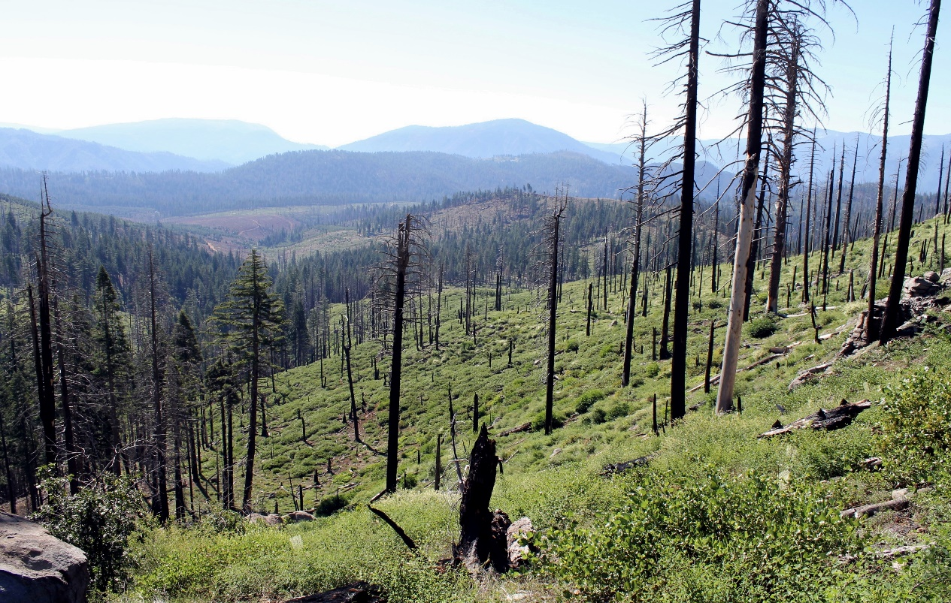
SEVERITY OF SHORT-INTERVAL REBURN MEDIATES COMPOSITIONAL SHIFTS IN FIRE-ADAPTED MONTANE SHRUBLANDS
Nemens, D.G., Varner, J. M. and Kathryn R. Kidd

Slide 2
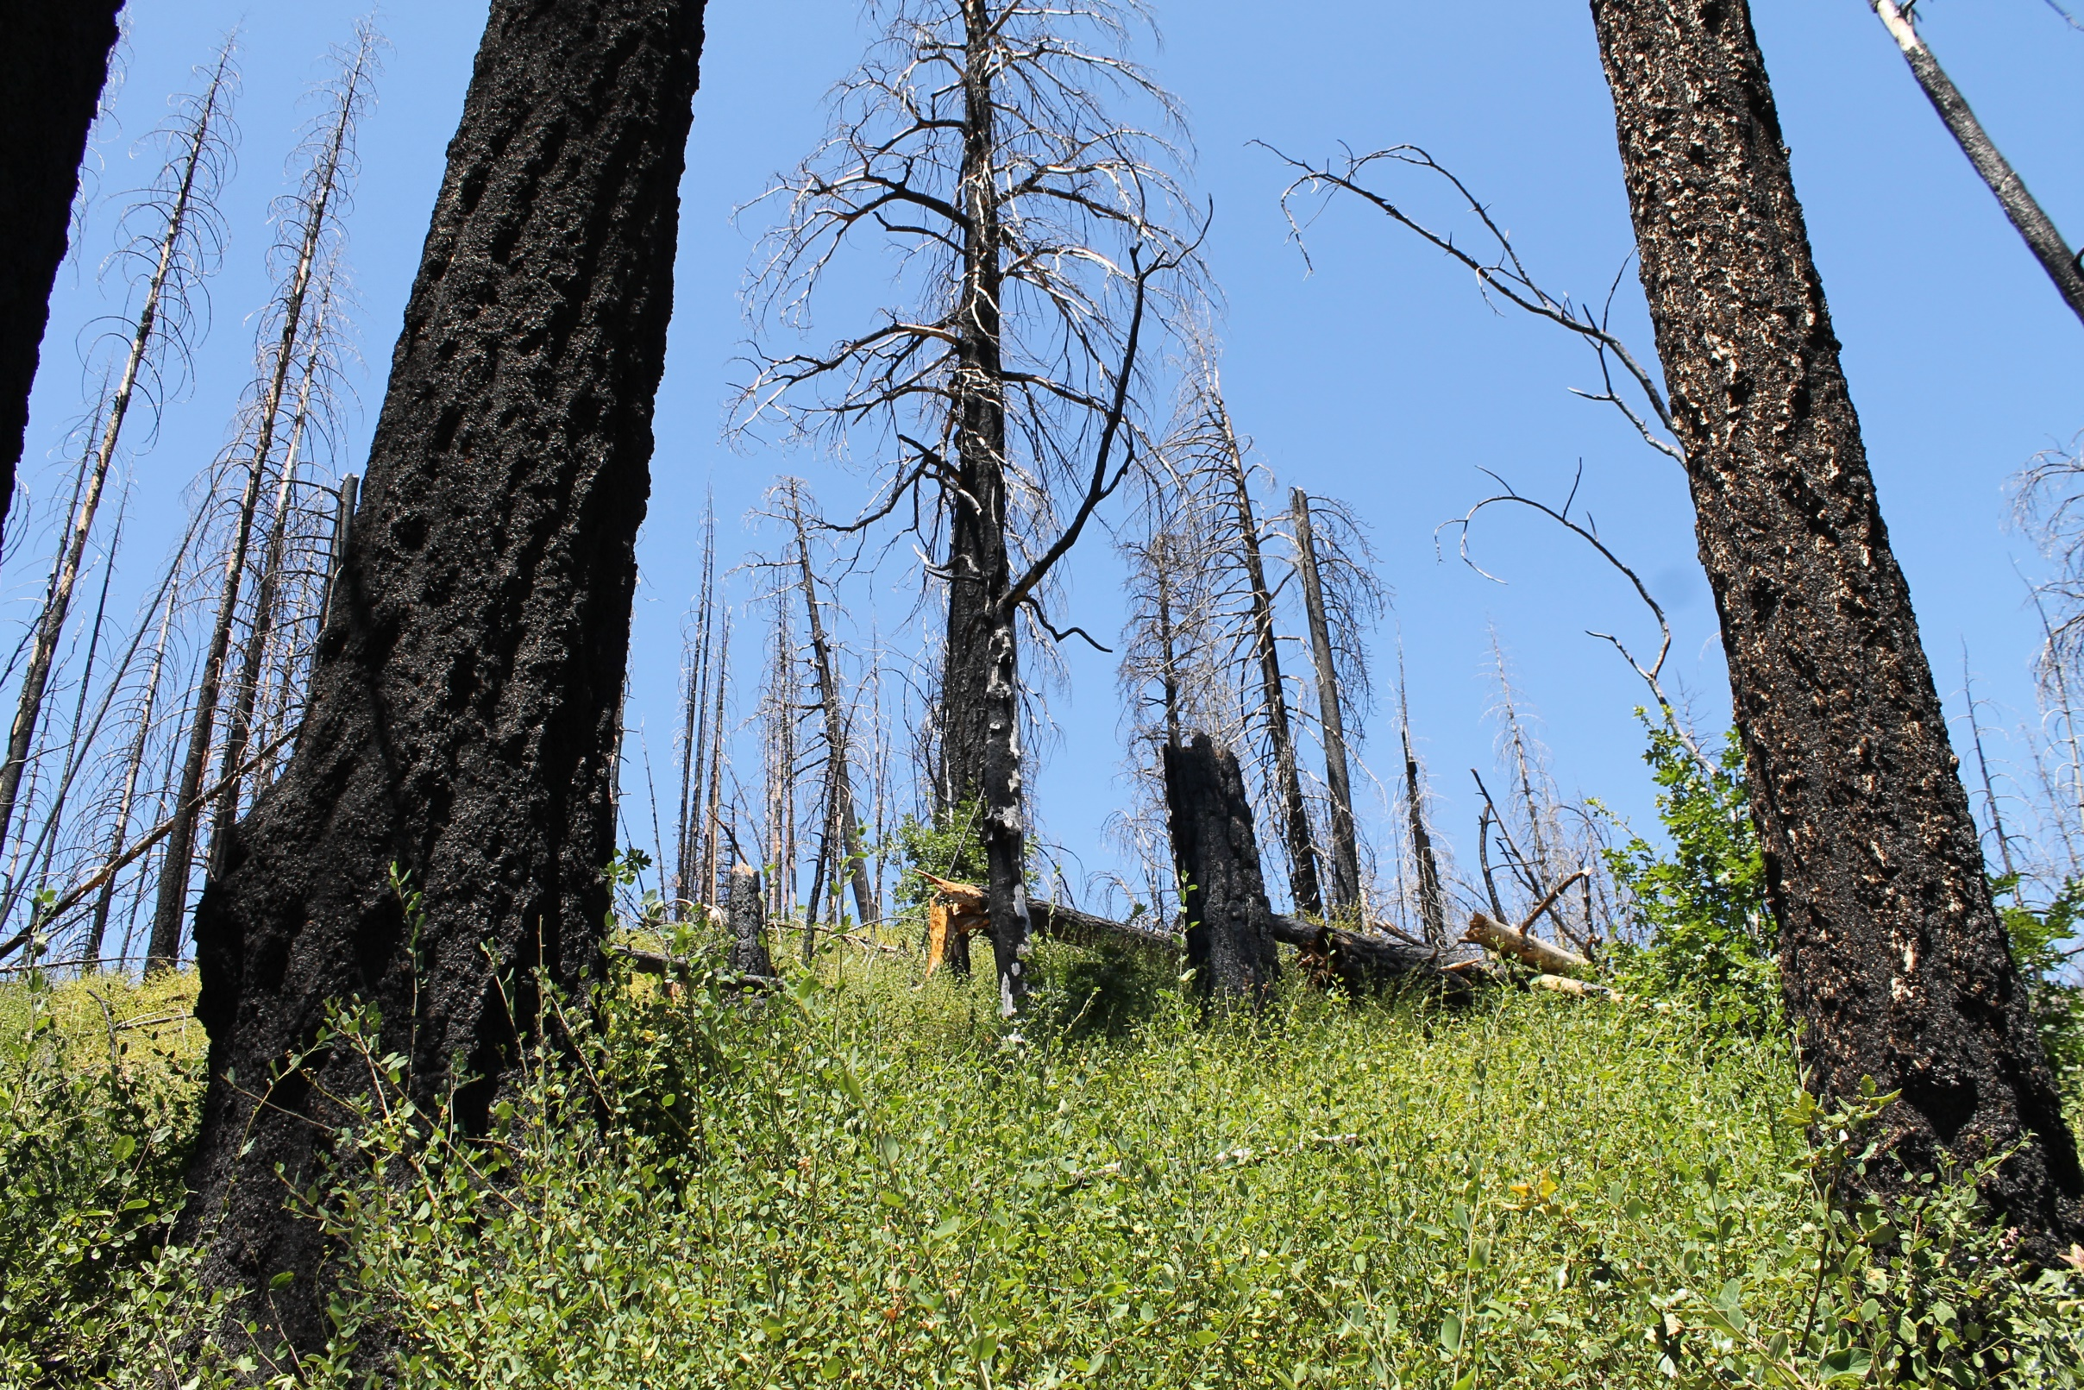
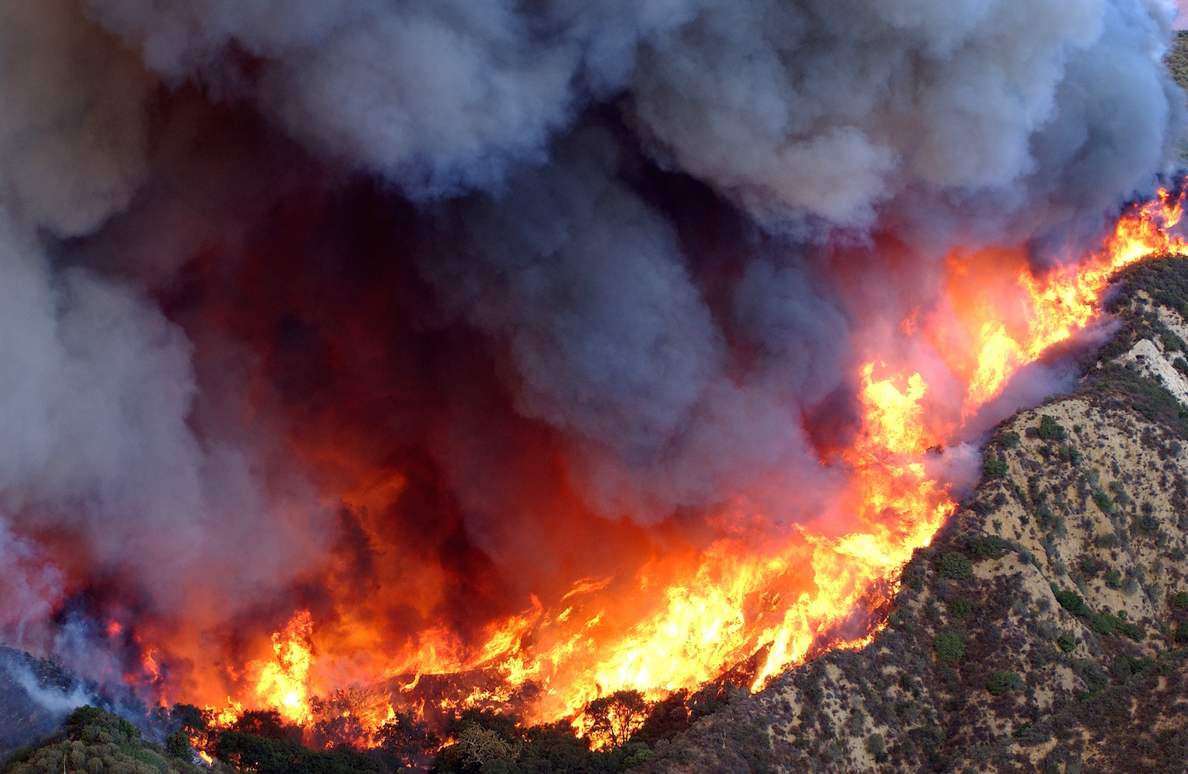
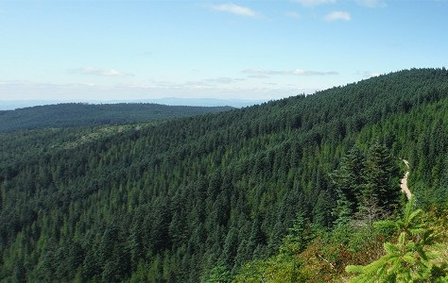
Notes:
I am going to start here with a familiar story – the legacy of past management practices, coupled with a warming climate, is the increasing incidence of large and severe wildfires. This is particularly the case in California, where wildfires are ever more damaging in regions that formerly saw frequent low and moderate severity fire. The net result is the loss of large areas of forest

Slide 3
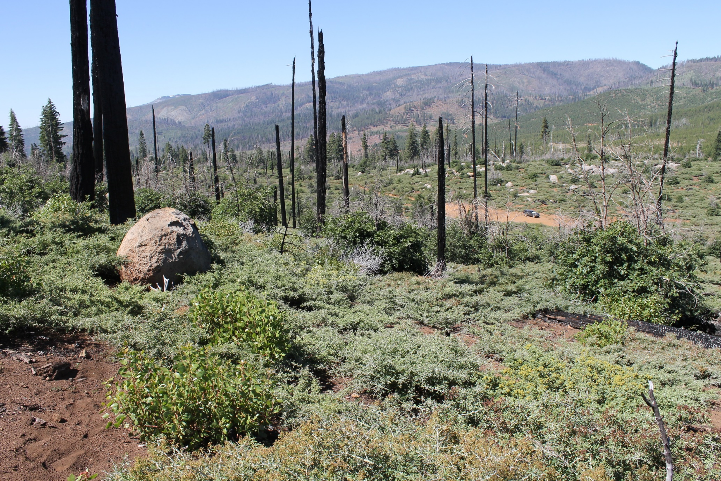
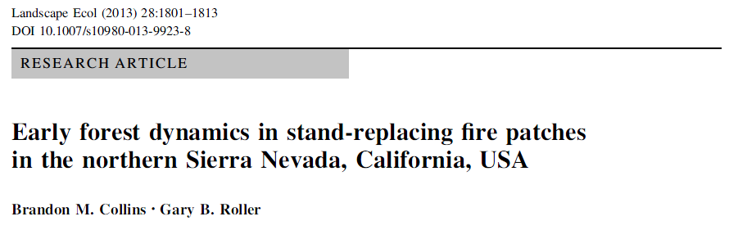
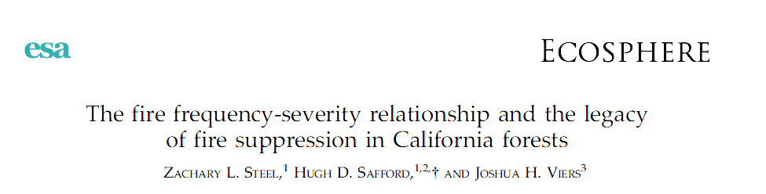
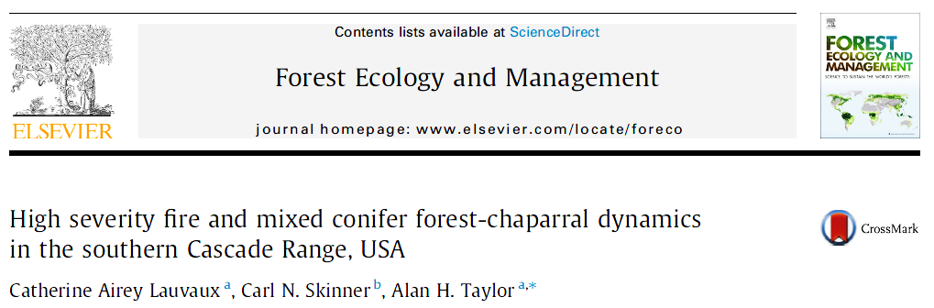
Notes:
But what happens after a reburn? An increasing body of knowledge suggests that with repeated wildfires, vegetative changes are self-reinforcing, and conversions from forest to shrubland are becoming more permanent

Slide 4
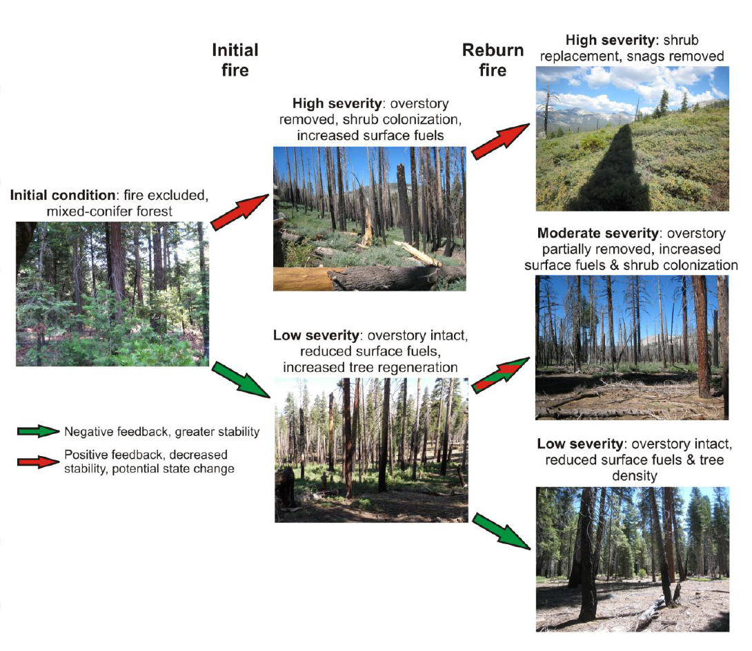
Alternative vegetative states
Initial fire
Re-burn
High severity
High severity
Initial condition
Moderate severity
Coppoletta et al. 2015 Ecosphere
Low severity
Low severity
Notes:
This centers on the concept of state shift, where post-fire shrub regeneration represents not a seral state initiated by severe disturbance, but an alternative vegetative state that is unlikely to convert back to forest.
These authors found that burning once at high severity increases the likelihood of burning again at high severity, creating a positive feedback of stand replacing fire that crosses an ecological threshold, representing a type-shift from one vegetative state to another.

Slide 5
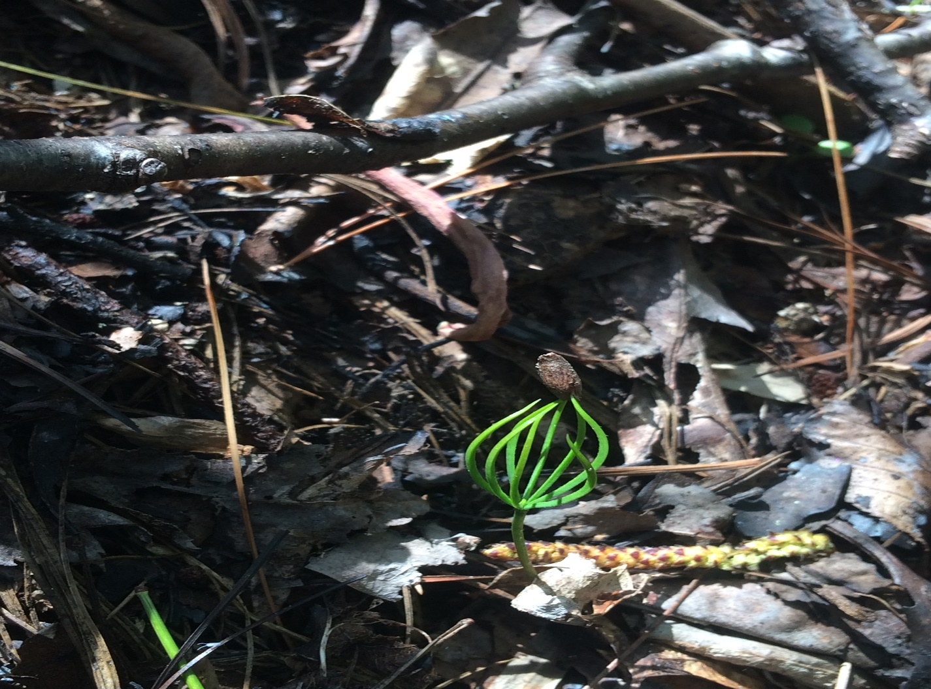
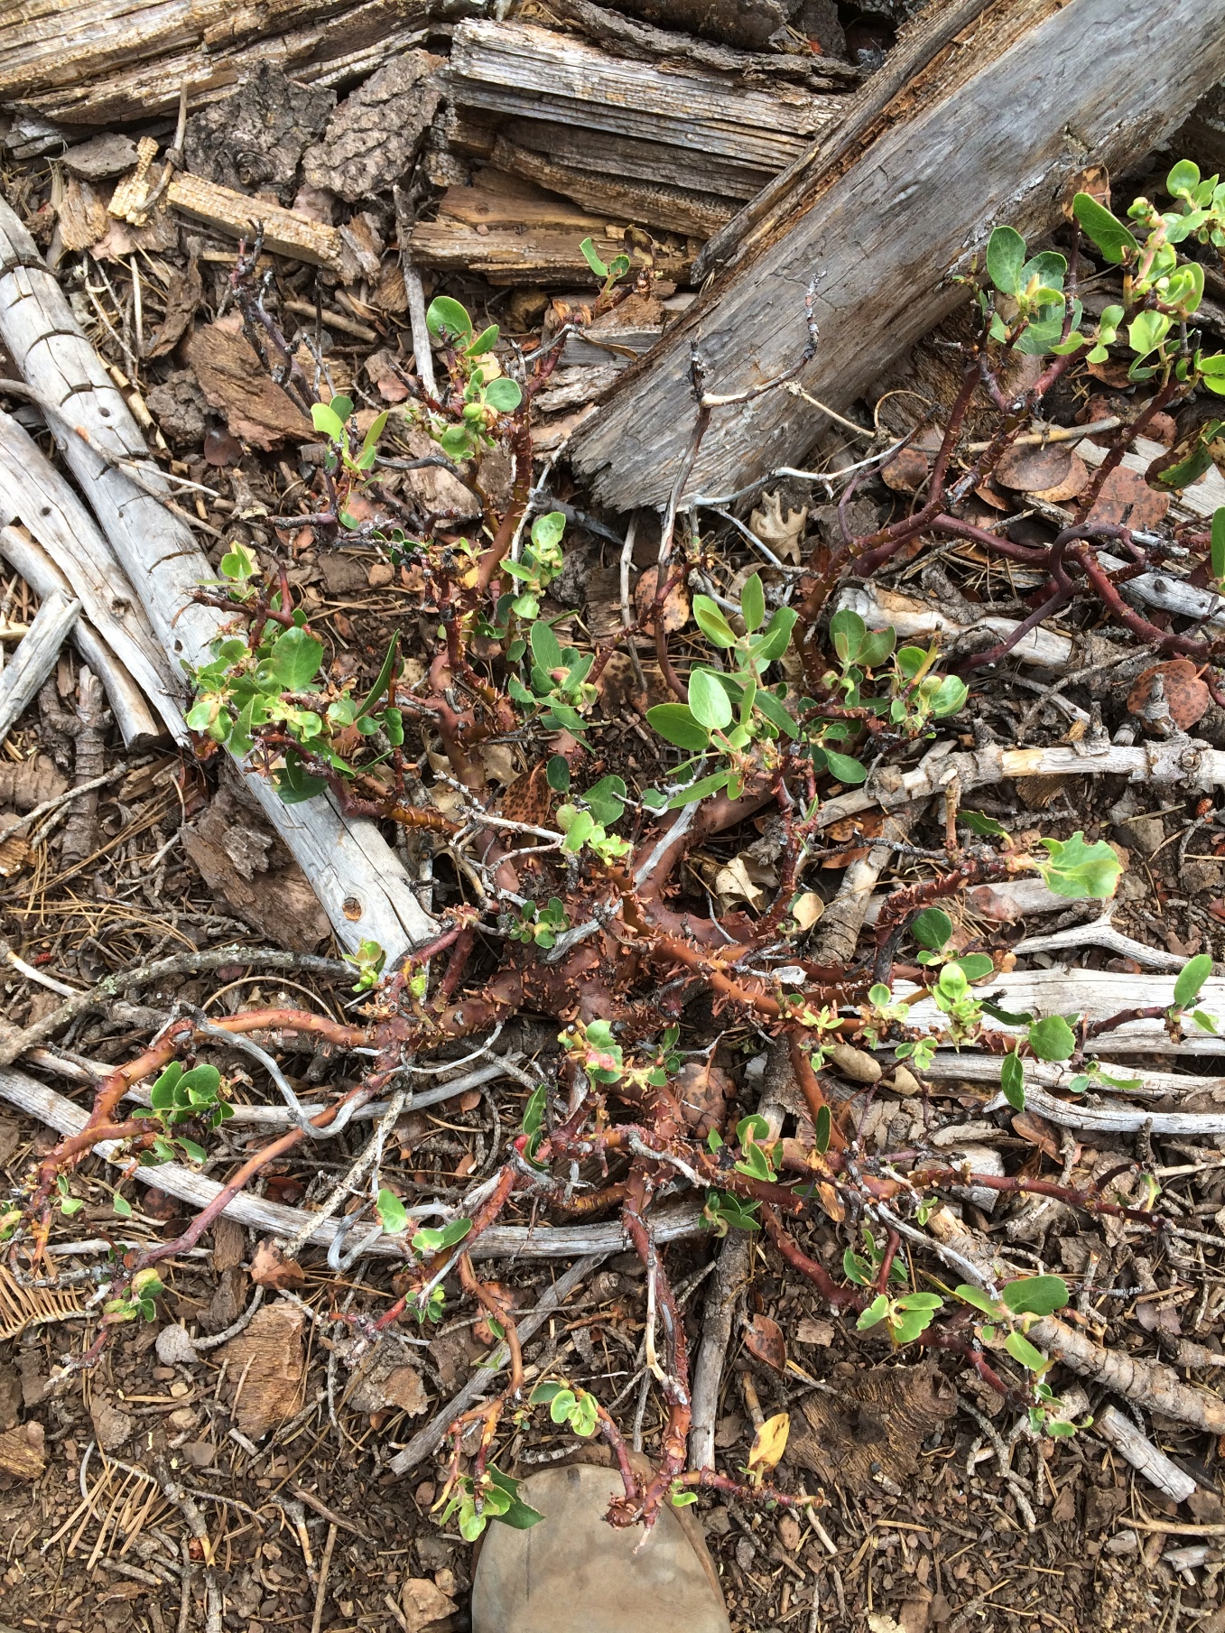
Post-fire regeneration strategies
Fire-stimulated germination
Basal sprouting
Notes:
But different plants have distinct post-fire regeneration strategies, which begs the question: during this self-reinforcing process, is there also a shift in plant community composition which may be driven by differential adaptations?

Slide 6
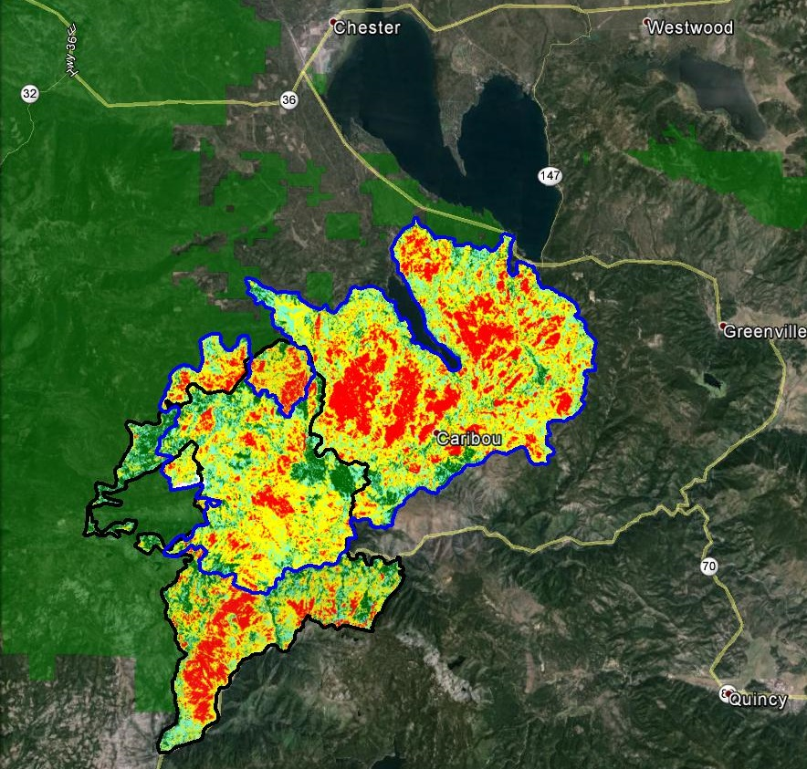
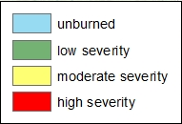
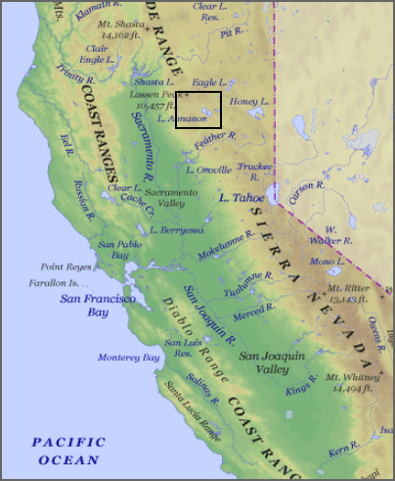
LASSEN NATIONAL FOREST
Chips Fire (2012)
Storrie Fire (2000)
Notes:
In order to study this, we looked at a reburn area in the Lassen National Forest: the Storrie Fire outlined in black occurred in 2000 – 20,000 hectares. Chips Fire in blue 2012 – 30,000 hectares. Reburn area was 9,000-hectares in size

Slide 7
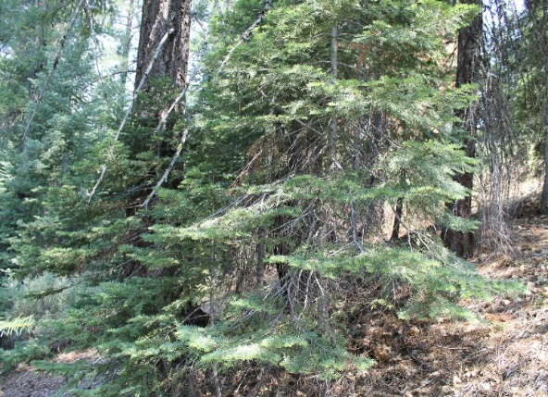
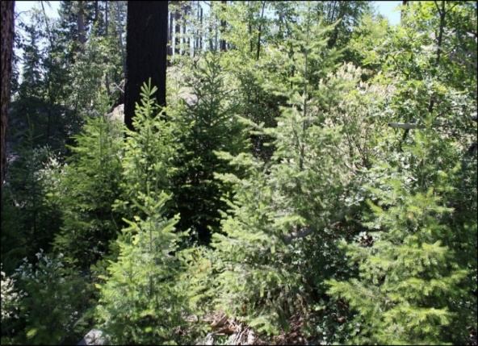
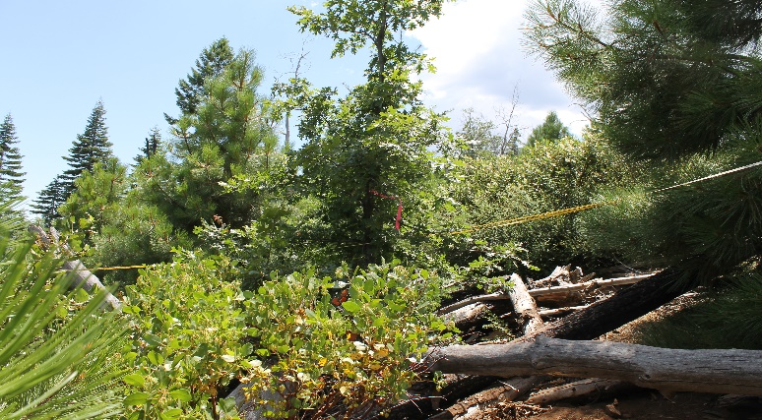
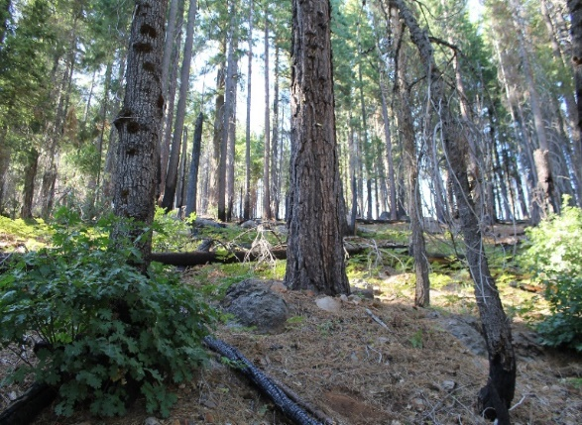
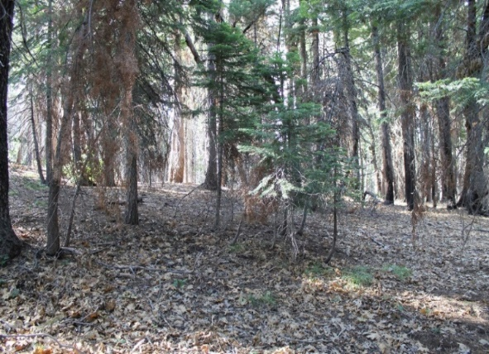
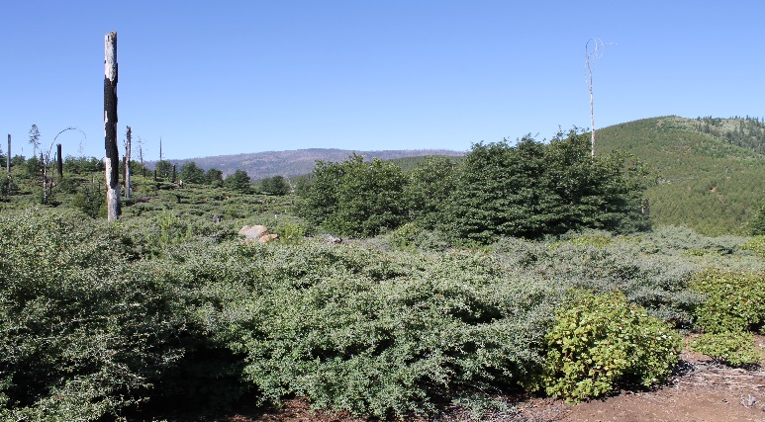
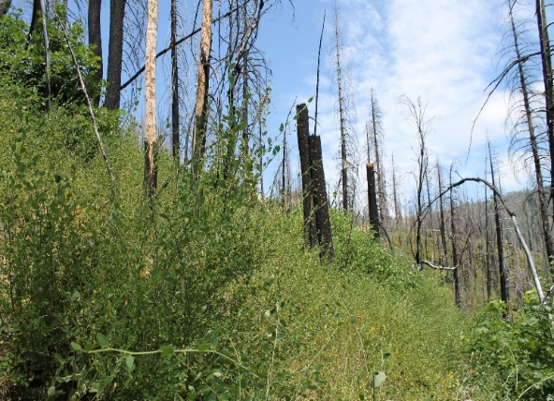
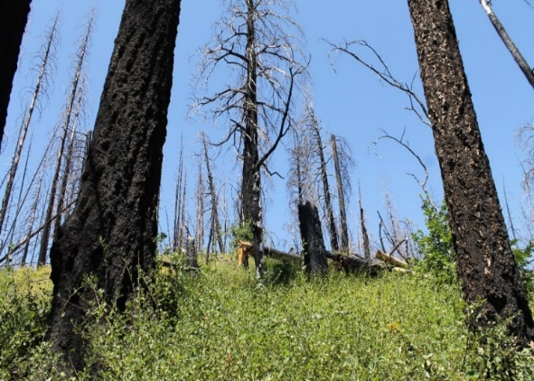
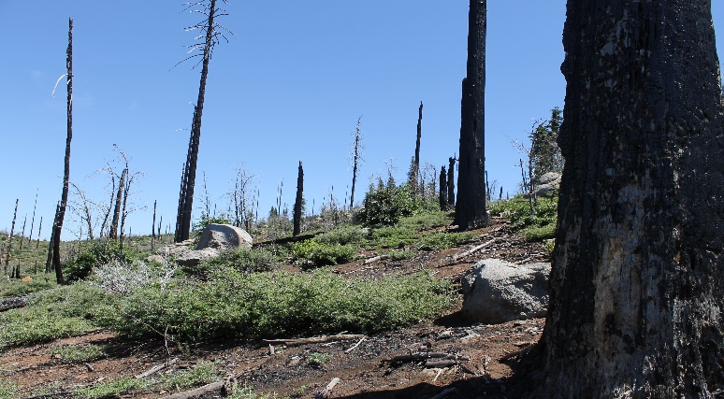
Storrie Fire - 2000
Un/Un
Low/Un
High/Un
Un/Low
Low/Low
High/Low
Chips Fire - 2012
Un/High
Low/High
High/High

Slide 8
Research Questions:
Were there compositional shifts in the mid-story across severity combinations?
Are some severity combinations favoring certain fire-adaptive traits?

Slide 9
Research Questions:
Were there compositional shifts in the mid-story across severity combinations?
Are some severity combinations favoring certain fire-adaptive traits?

Slide 10
Research Questions:
Were there compositional shifts in the mid-story across severity combinations?
Are some severity combinations favoring certain fire-adaptive traits?

Slide 11
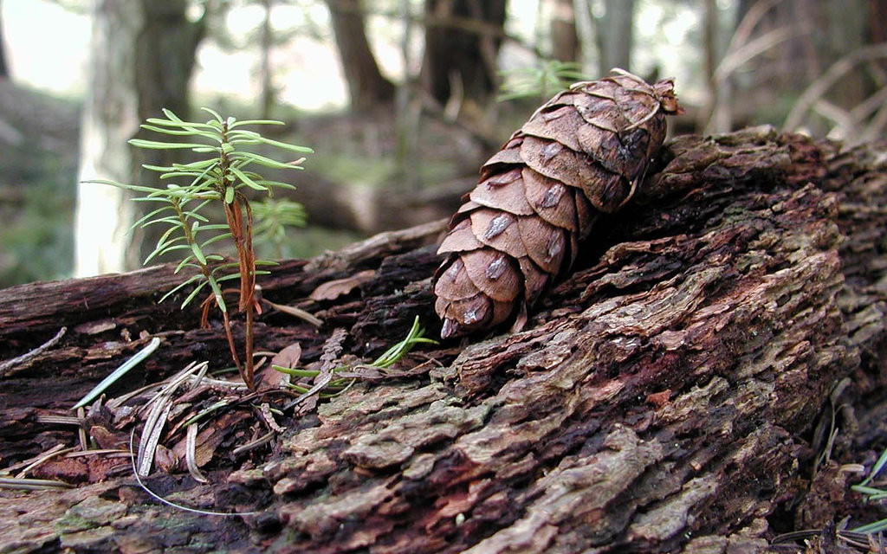
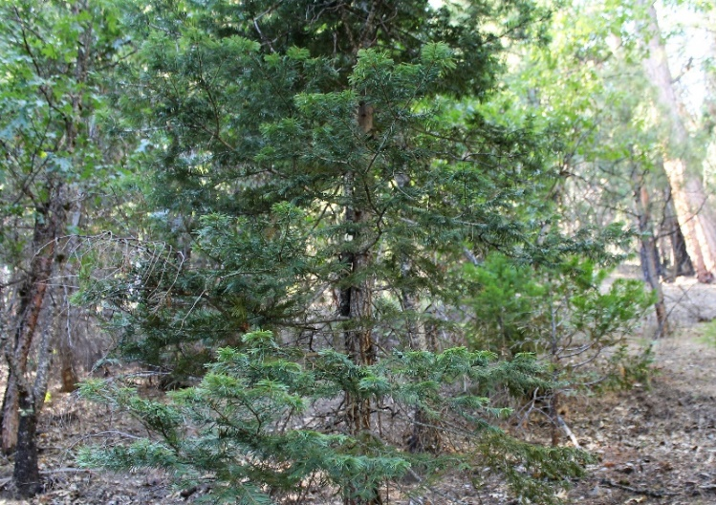
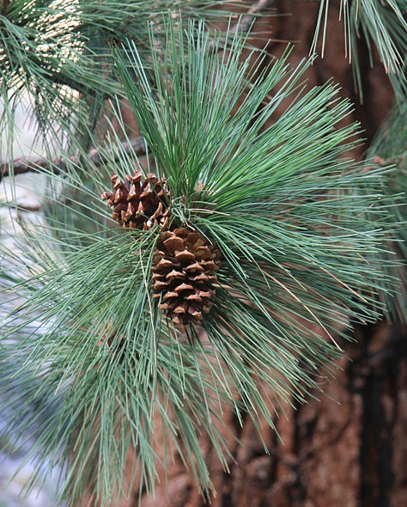
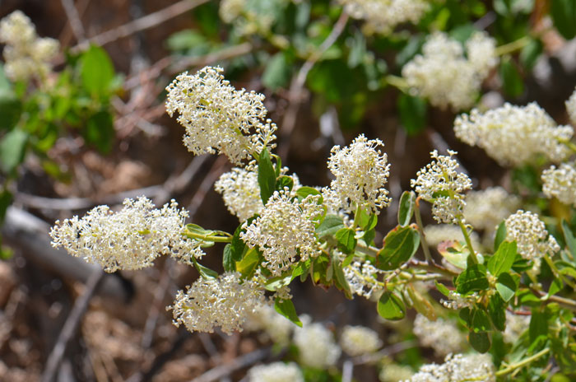
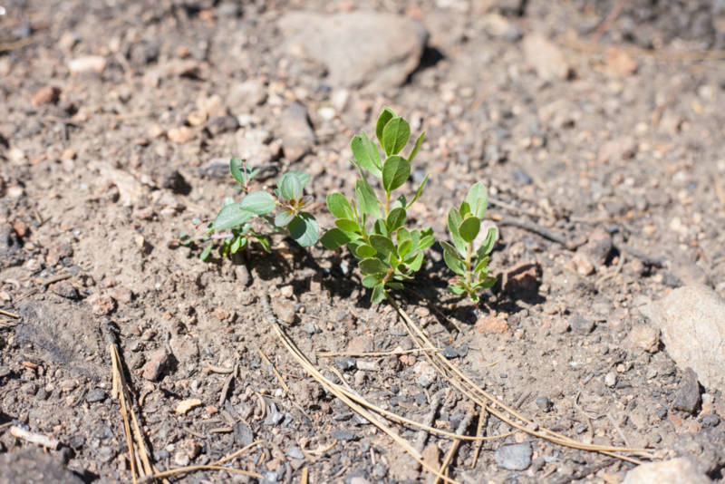
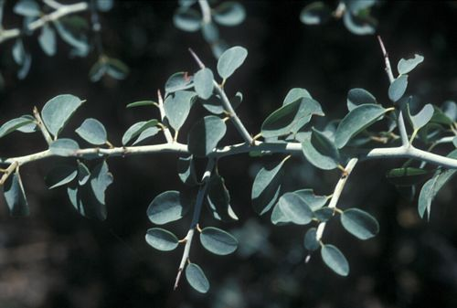
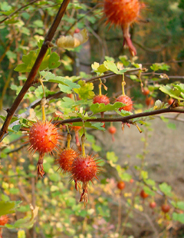
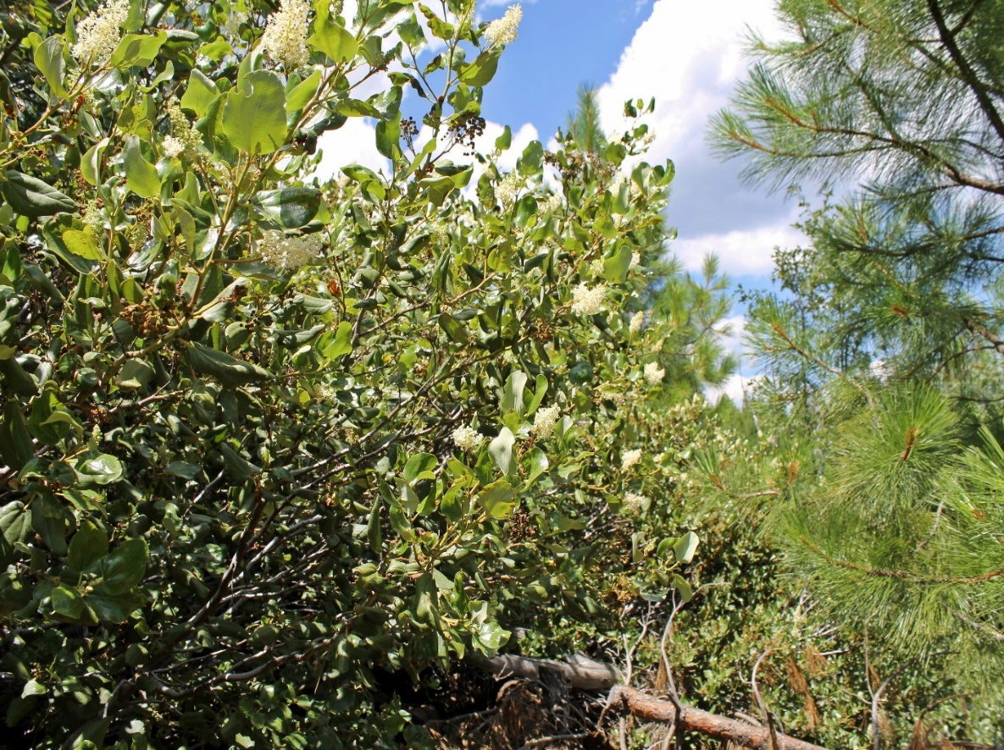
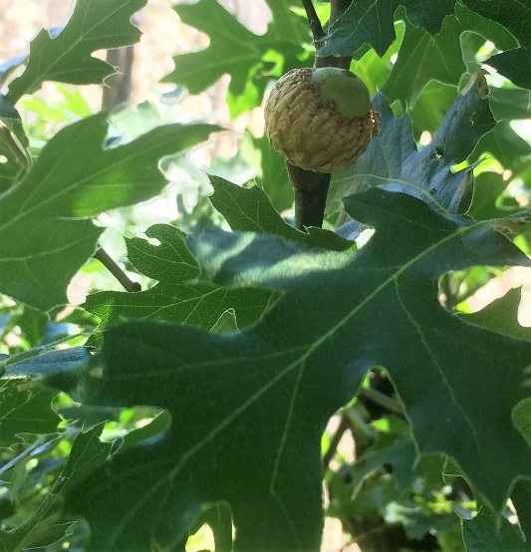
Douglas-fir
(Pseudotsuga menziesii)
White fir
(Abies concolor)
Ponderosa pine
(Pinus ponderosa)
Douglas-fir
(Pseudotsuga menziesii)
Seeders
Deerbrush
(Ceanothus integerrimus)
Mountain whitethorn
(Ceanothus cordulatus)
Deerbrush
(Ceanothus integerrimus)
Greenleaf manzanita
(Arctostaphylos patula)
Seeders
Facultative seeder/sprouters
Sierra gooseberry
(Ribes roezlii)
Snowbrush
(Ceanothus velutinus)
California black oak
(Quercus kelloggii)
Sierra gooseberry
(Ribes roezlii)
Sprouters
Notes:
Conifers, which depend on seed germination
Some shrubs and hardwoods, most often rely on sprouting from basal bud banks or lignotubers
But some species are able to employ multiple regeneration mechanisms, often dependent on the intensity of the fire.

Slide 12
Indicator species analysis
Specificity/
Relative abundance
Fidelity/
Relative frequency
Dufrêne & Legendre, 1997
Notes:
The authors arbitrarily chose a threshold level of 25% for the index, which supposes that a characteristic species is present in at least 50% of one site group and that its relative abundance in that group reaches at least 50%.

Slide 13

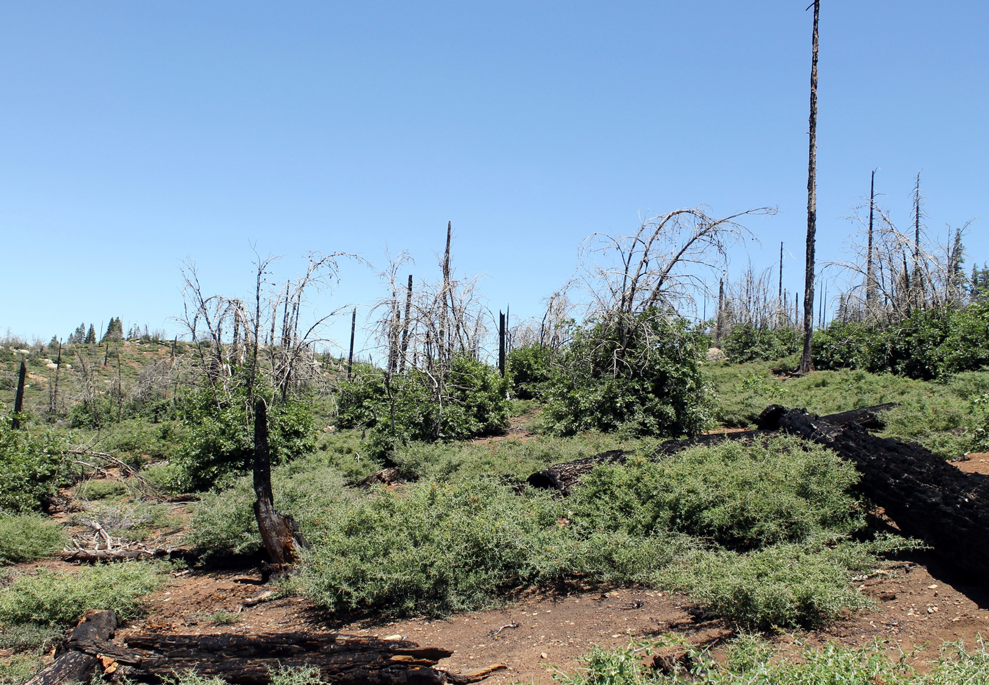


Indicator species analysis
Deerbrush
(Ceanothus integerrimus)
Mountain whitethorn
(Ceanothus cordulatus)
Un/Un
Un/High
High/High
White fir
(Abies concolor)
25
31
45
California black oak
(Quercus kelloggii)
Douglas-fir
(Pseudotsuga menziesii)
Low/Low
44
31
Notes:
Mountain whitethorn, which, according to a young botanist friend of mine, has a high “poky factor”

Slide 14
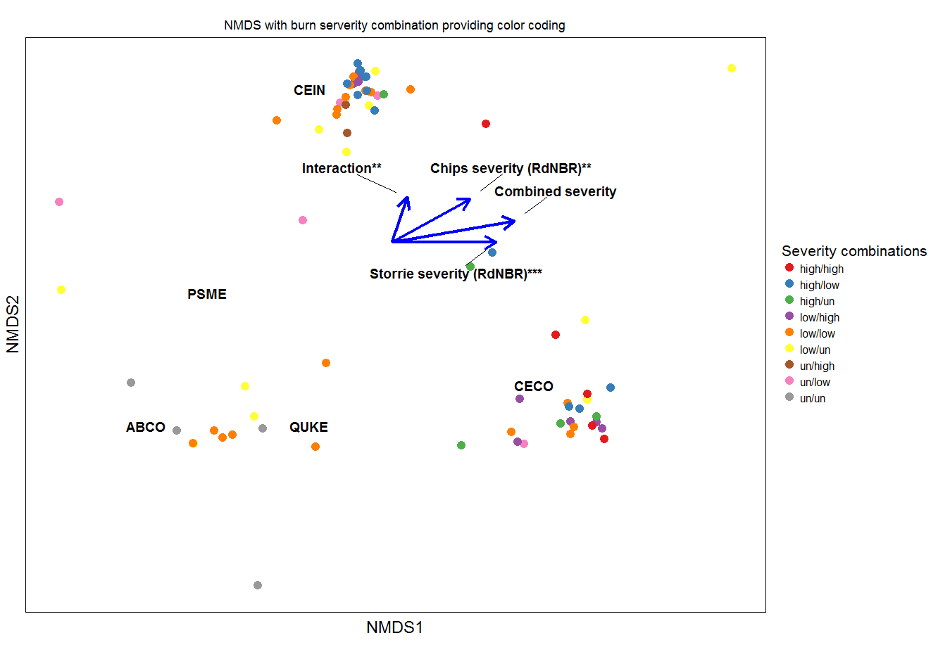

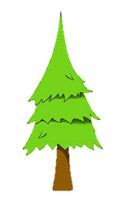
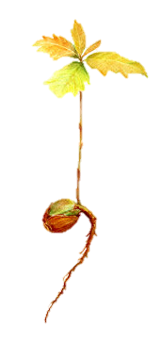
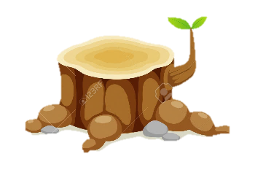

Severity-dependent response
Notes:
Ordination of our plots helps us visualize the differences in species composition among groups of burn severitycombinations

Slide 15

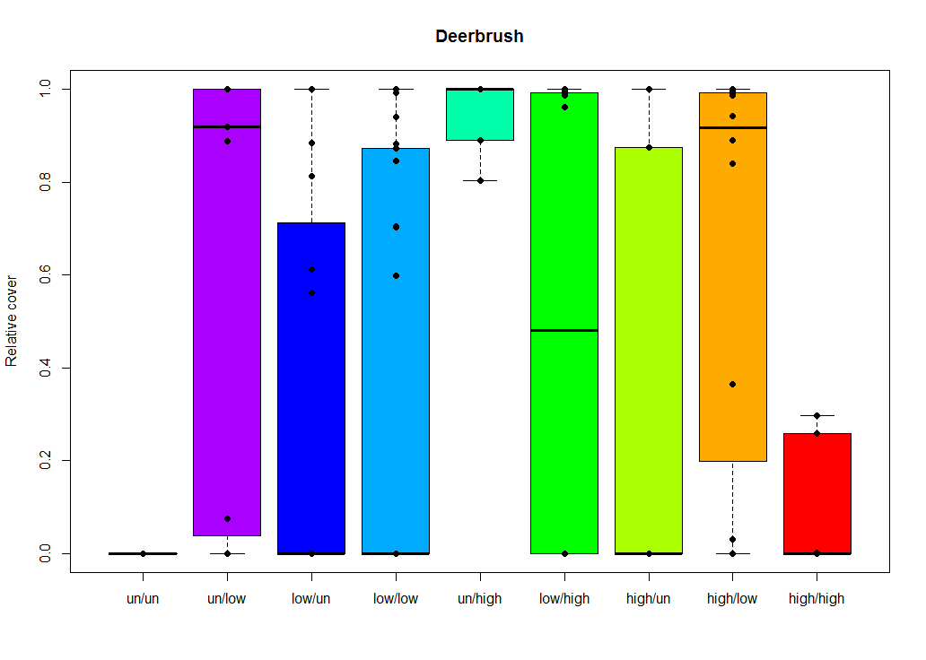
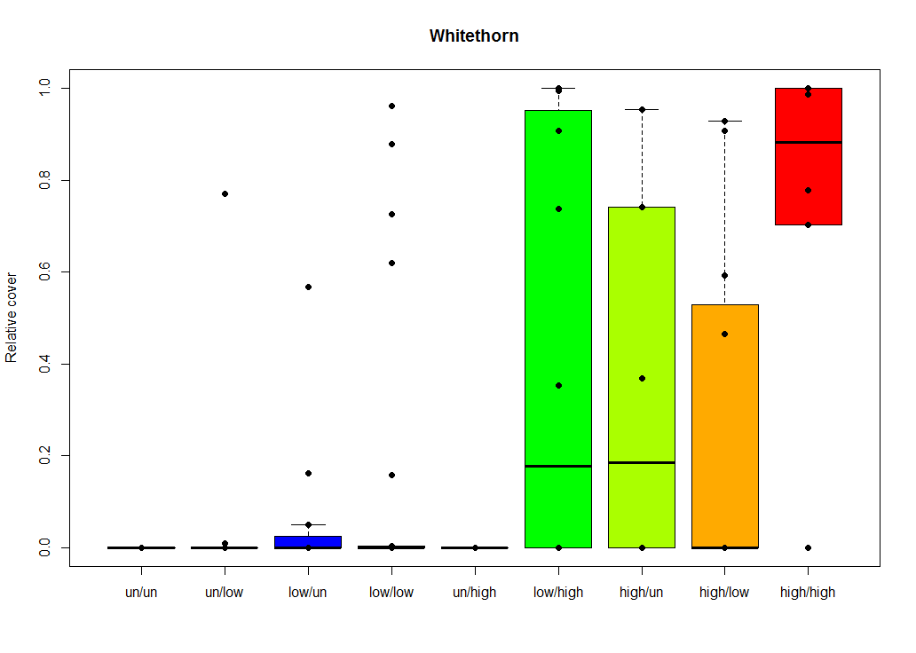
Shrubs

Slide 16
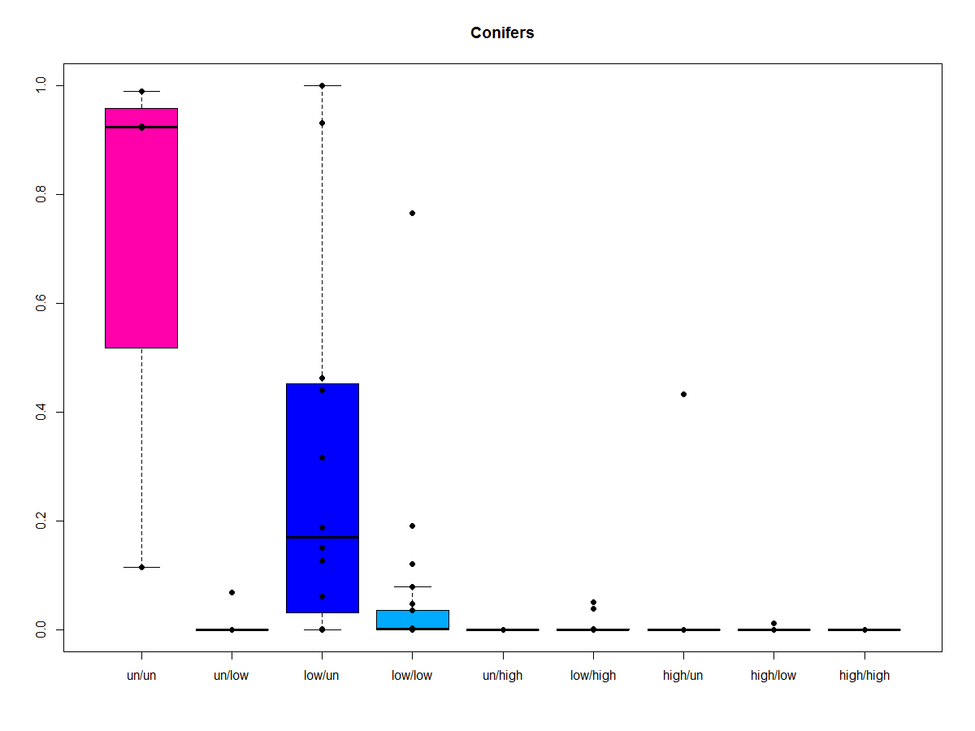
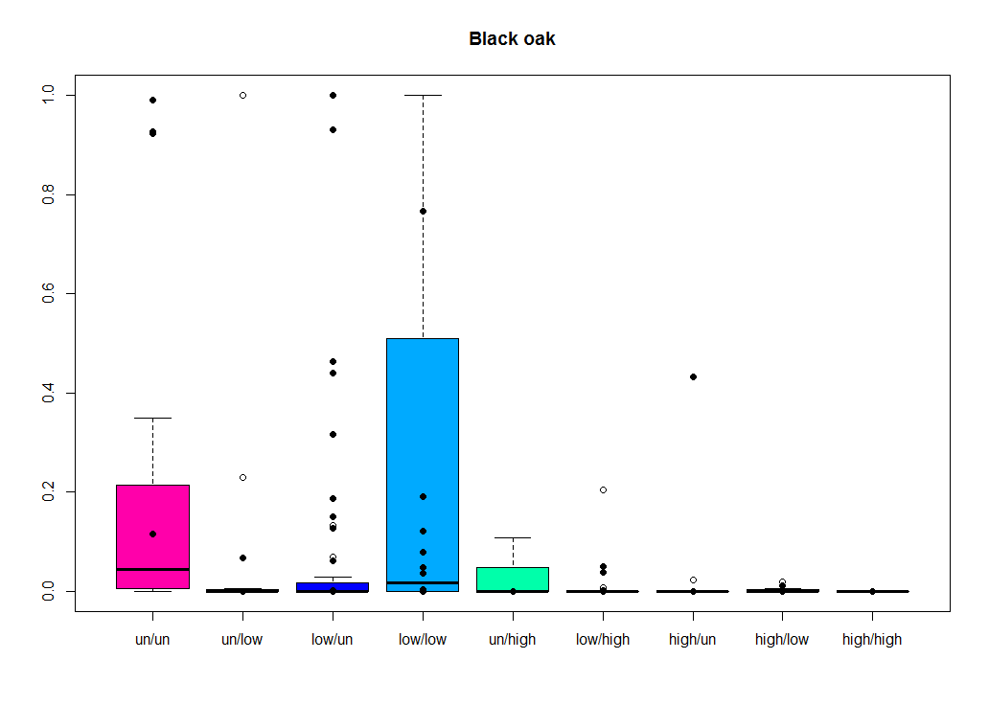
Trees

Slide 17
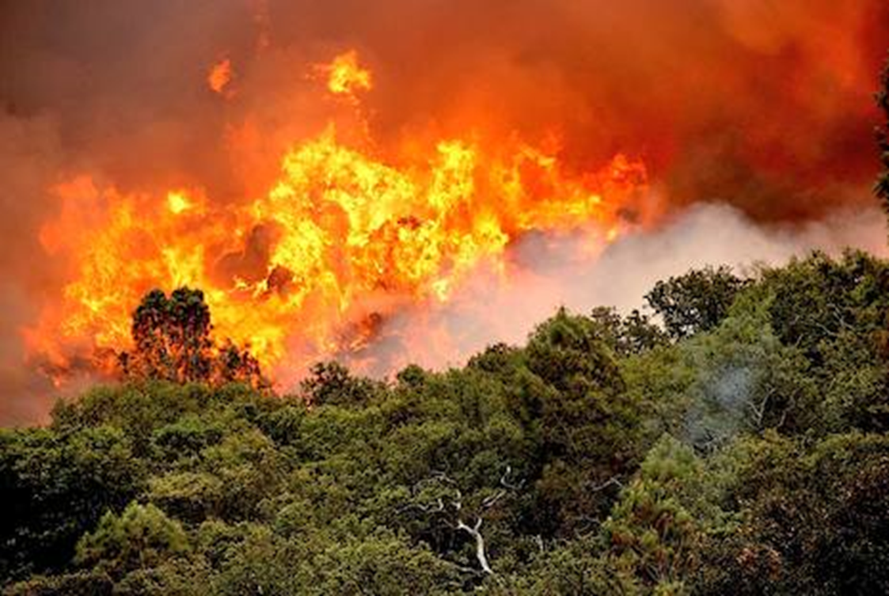
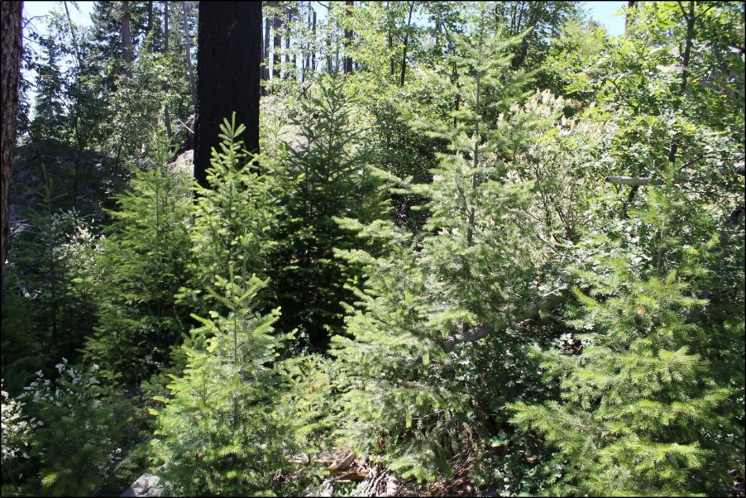
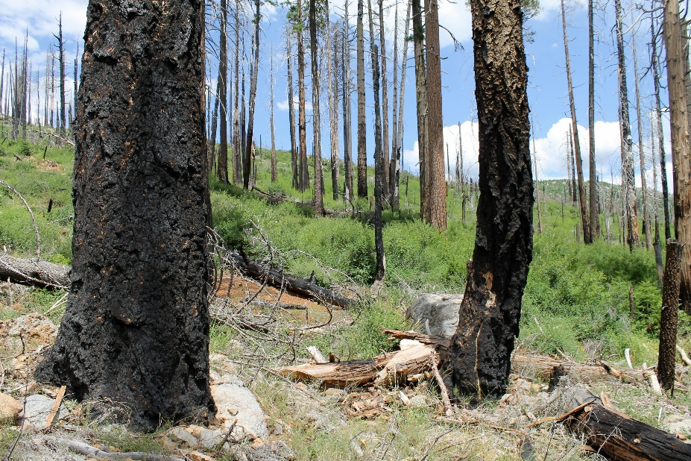
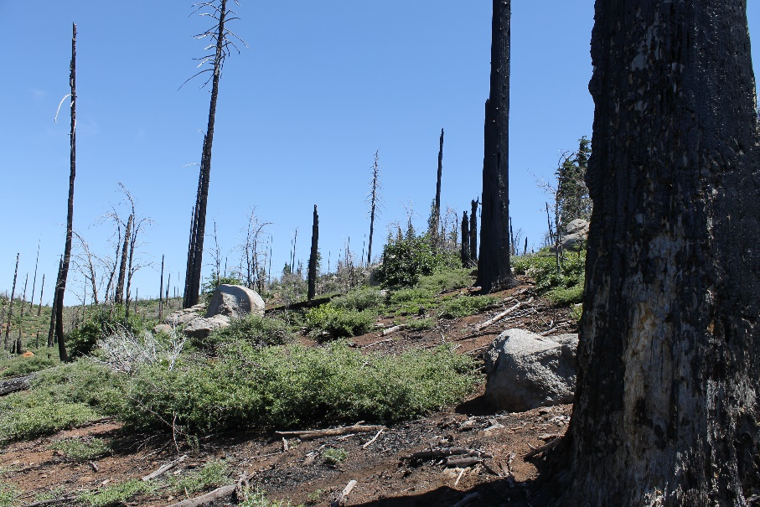
Implications:
Type shift – self-reinforcing
Regeneration strategies
Interval dependence?
Future fire behavior?

Slide 18
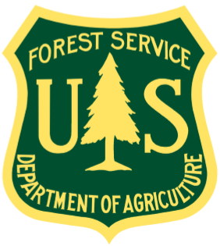

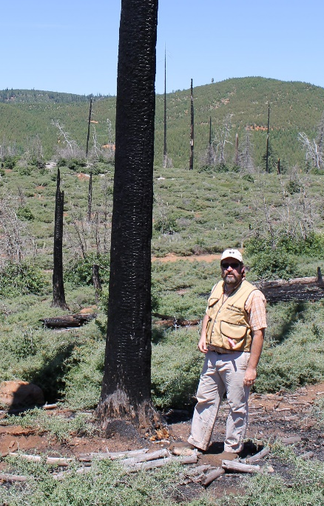
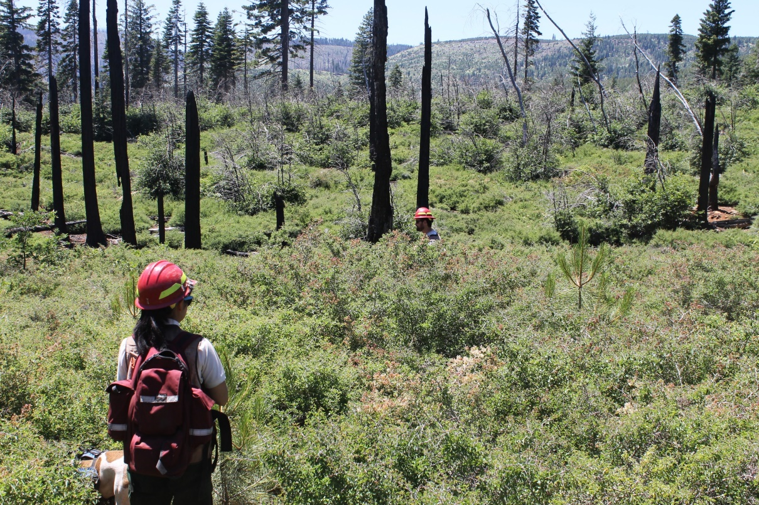
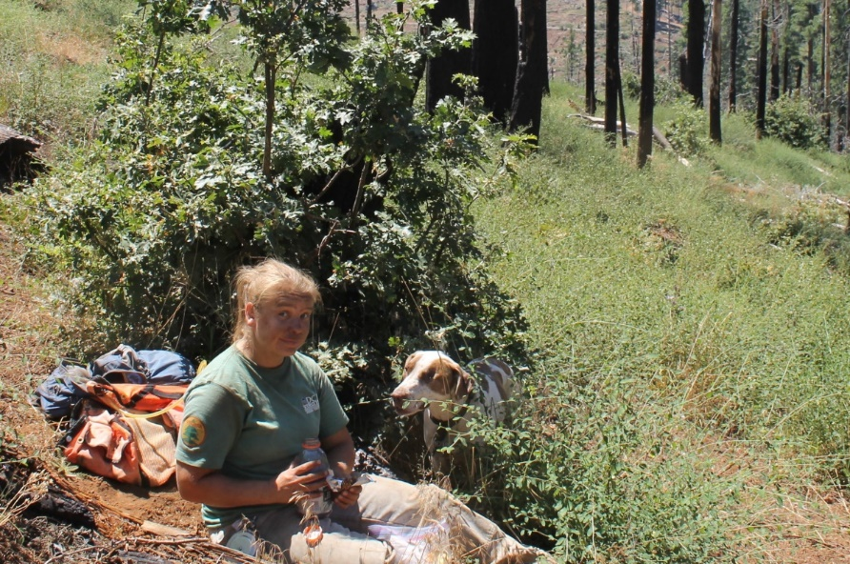
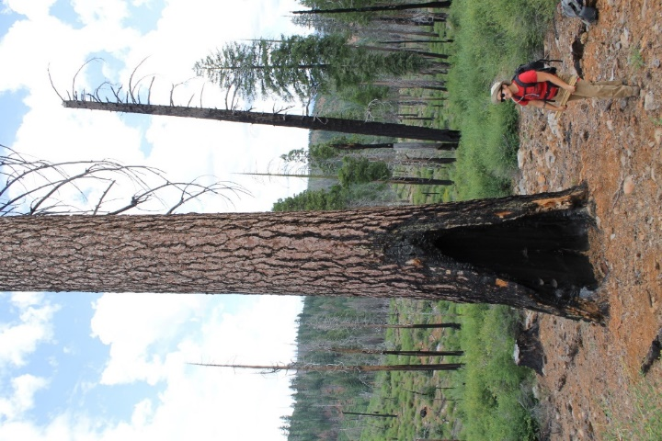
Acknowledgements
Notes:
Funded by USDA Forest Service Region 5
Would like to acknowledge many collaborators on this project, especially some very hard-working field assistants.

Slide 19



Thank you!
Deborah Nemens
Pacific Wildland Fire Sciences Lab
Seattle, WA
dnemens@uw.edu

Slide 20

Seedling density
Low | High Low
Low High | High

Slide 21

Design
Storrie Fire
2000
un-un
Chips Fire
2012
low-low
high-high
-500
RdNBR
1100

Slide 22
Montane chaparral

Slide 23





Slide 24


Obligate seeders
Obligate sprouters
Mountain whitethorn
(Ceanothus cordulatus)
Deerbrush
(Ceanothus integerrimus)
Sierra gooseberry
(Ribes roezlii)
Greenleaf mazanita
(Arctostaphylos patula)
Snowbrush
(Ceanothus velutinus)
Facultative sprouter/seeders:
Severity-dependent fire response

